Slide 1
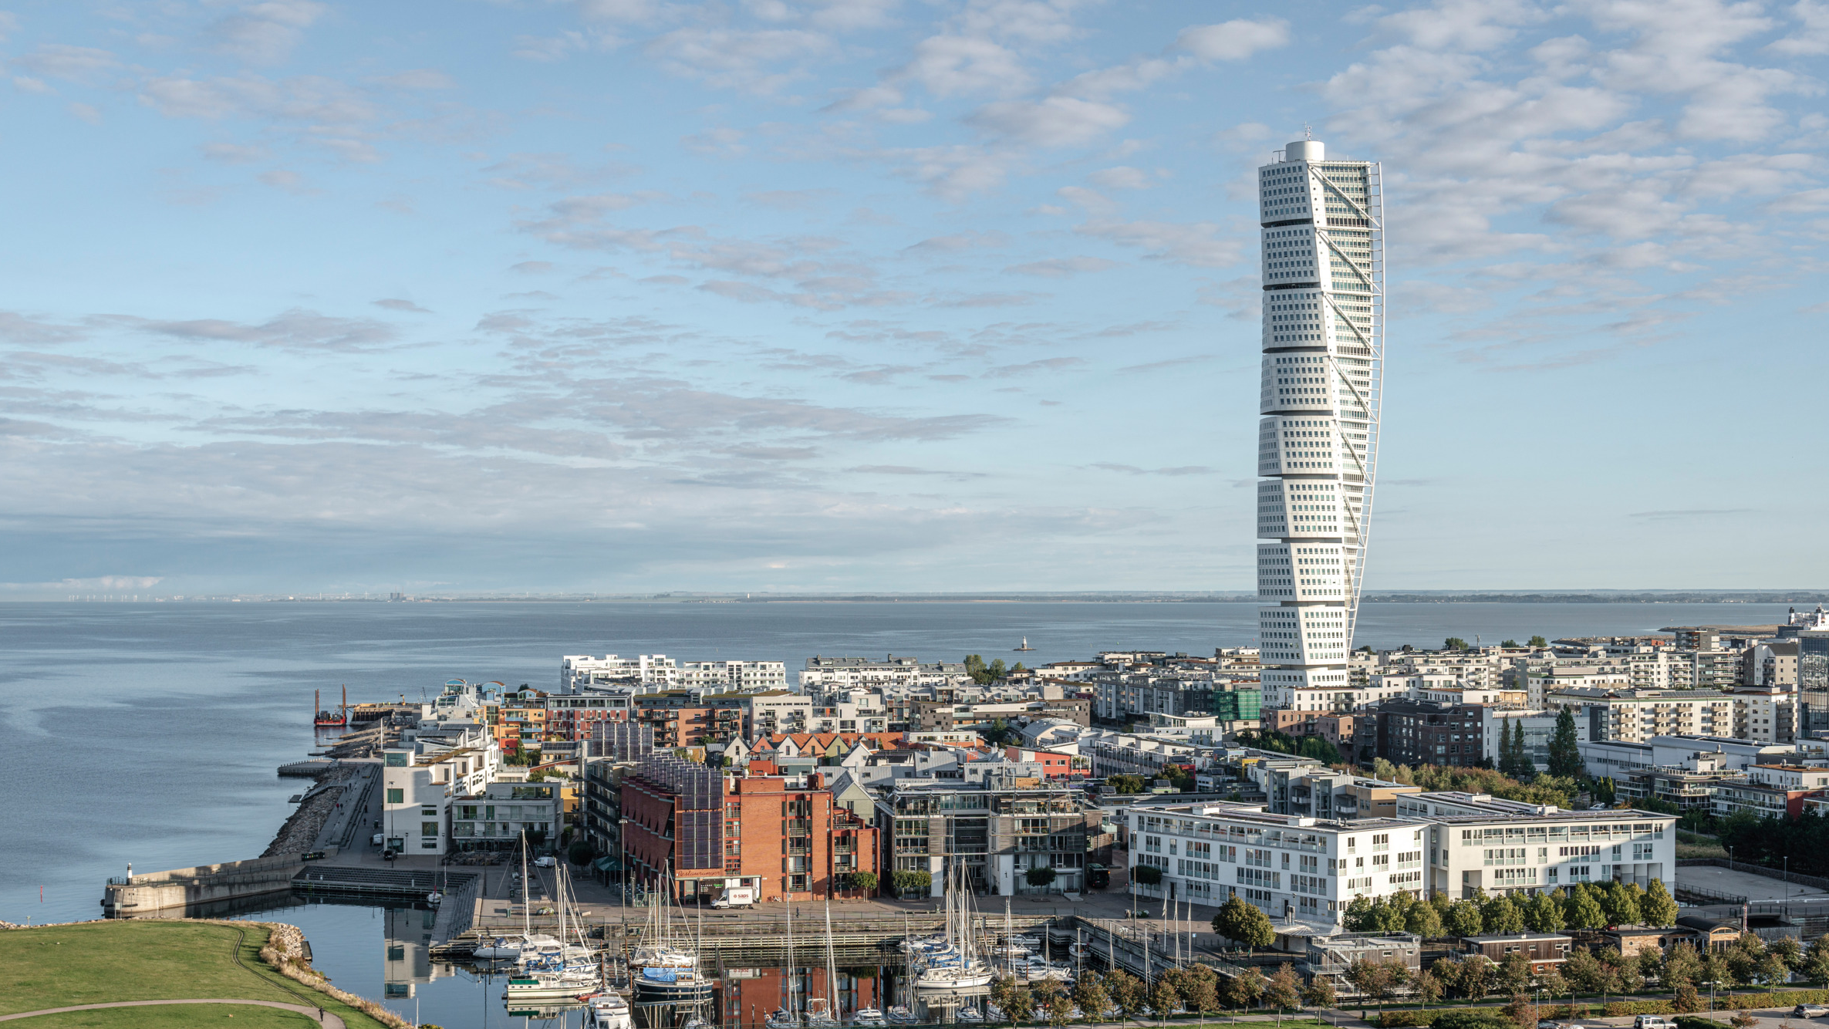
Practice report
ITALIAN SUPER MARKET
ROMAN LONGAUER, V. A 2024/25

Slide 2
Content
Malmö
Information about the company
Contact details
Italian Super Market
The goal of the company
Founder of Italian Super Market
Photos of Italian Super Market
Workplace
Descriptions of activities performed
Contribution from practise
Activities performed
Journal 1 + 2
Used information
END

Slide 3
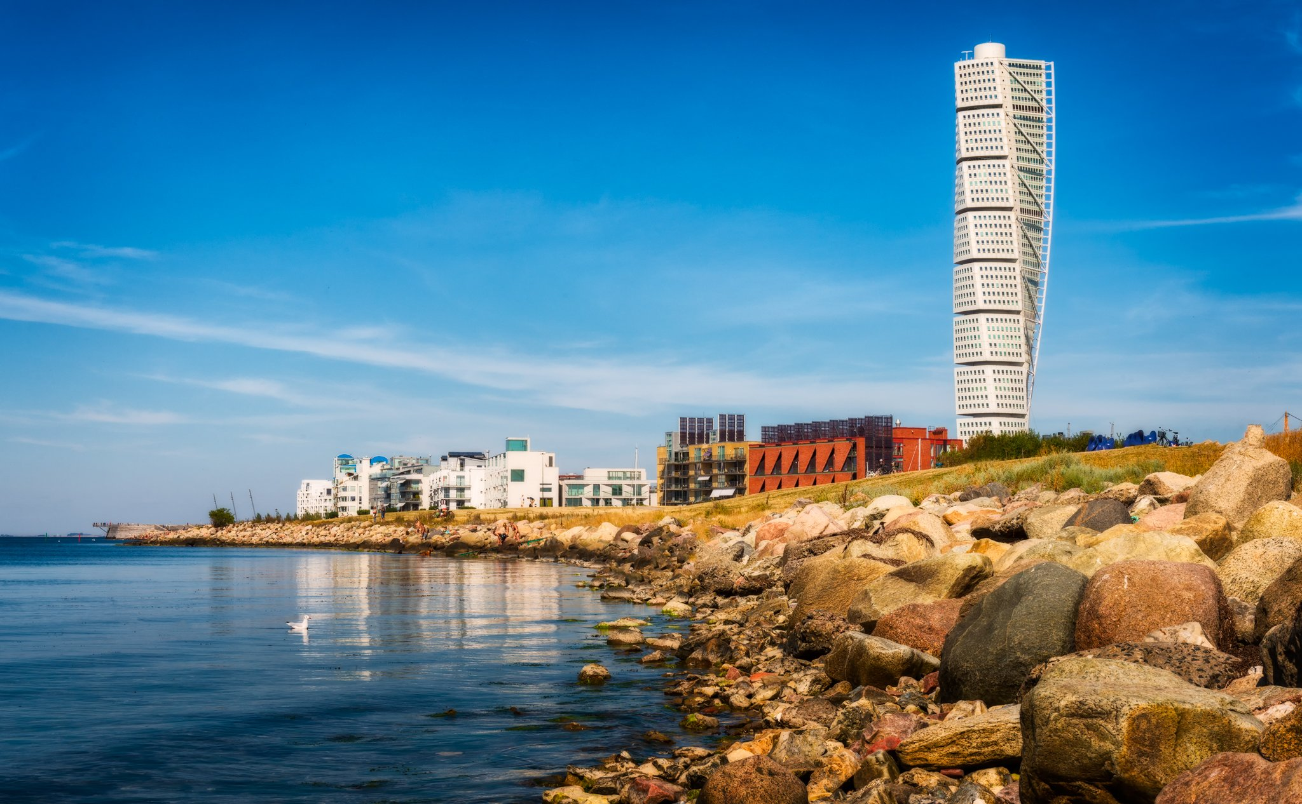
Malmö
Turning Torso
Malmö is the largest city in the Swedish county of Skåne.
It is the third-largest city in Sweden, after Stockholm and Gothenburg
Population of 362,133 in December 2023
The Öresund Bridge, connecting Malmö to Copenhagen
Turning Torso, the skyscraper is 190 meters high and has 54 floors
Öresund Bridge

Slide 4
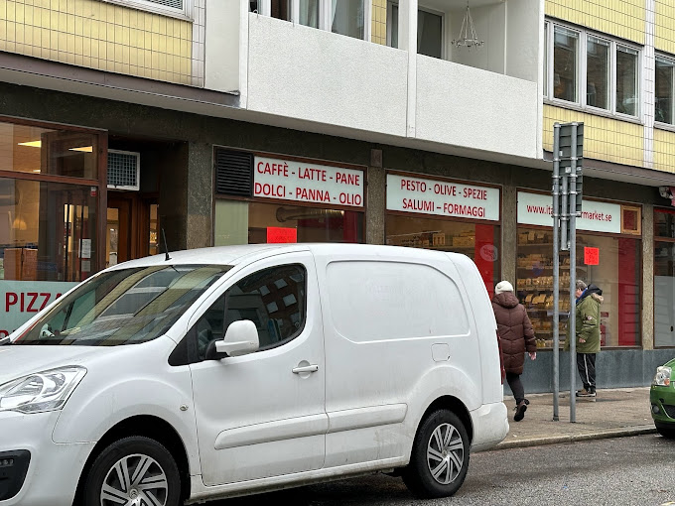
Information about the company
Name of the company: Italian Super Market
Adress: Holmgatan 11, 211 45 Malmö
Legal norm: limited ( liability ) company
Subject of business: purchase of goods for the purpose of selling them to the final consumer
WEB: https://vespa.nu/supermarket/
Email: info@vespa.nu

Slide 5
CONTACT DETAILS
Holmgatan 11, 211 45 Malmö
+46 (0) 40 605 92 50
https://vespa.nu/supermarket/

Slide 6
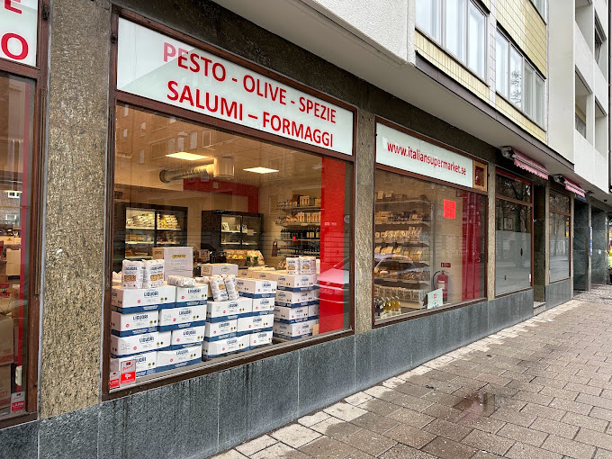
Italian Super Market
located at Holmgatan 11 in Malmö
grocery store which specializes in authentic Italian products, including a wide selection of olive oils, cheeses, cured meats, pasta, canned goods, sweets, and beverages like coffee.
The supermarket works with Italian suppliers, many of whom are family-run businesses that share a commitment to quality, sustainability, and a passion for Italian food culture.

Slide 7
The goal of the company
The goal of the Italian Supermarket and its associated V.E.S.P.A brand is to promote authentic Italian food culture by offering high-quality, carefully sourced Italian products.
They aim to create a community-focused space where customers can experience Italian cuisine both by shopping for groceries and enjoying prepared meals in a welcoming environment.

Slide 8
Founder of Italian Super Market
Company is owned and operated by the Mondolfi family. The family has a deep-rooted passion for Italian food culture, with Riccardo Mondolfi at the helm, leveraging over 30 years of experience importing high-quality Italian products to Sweden.
Riccardo Mondolfi

Slide 9
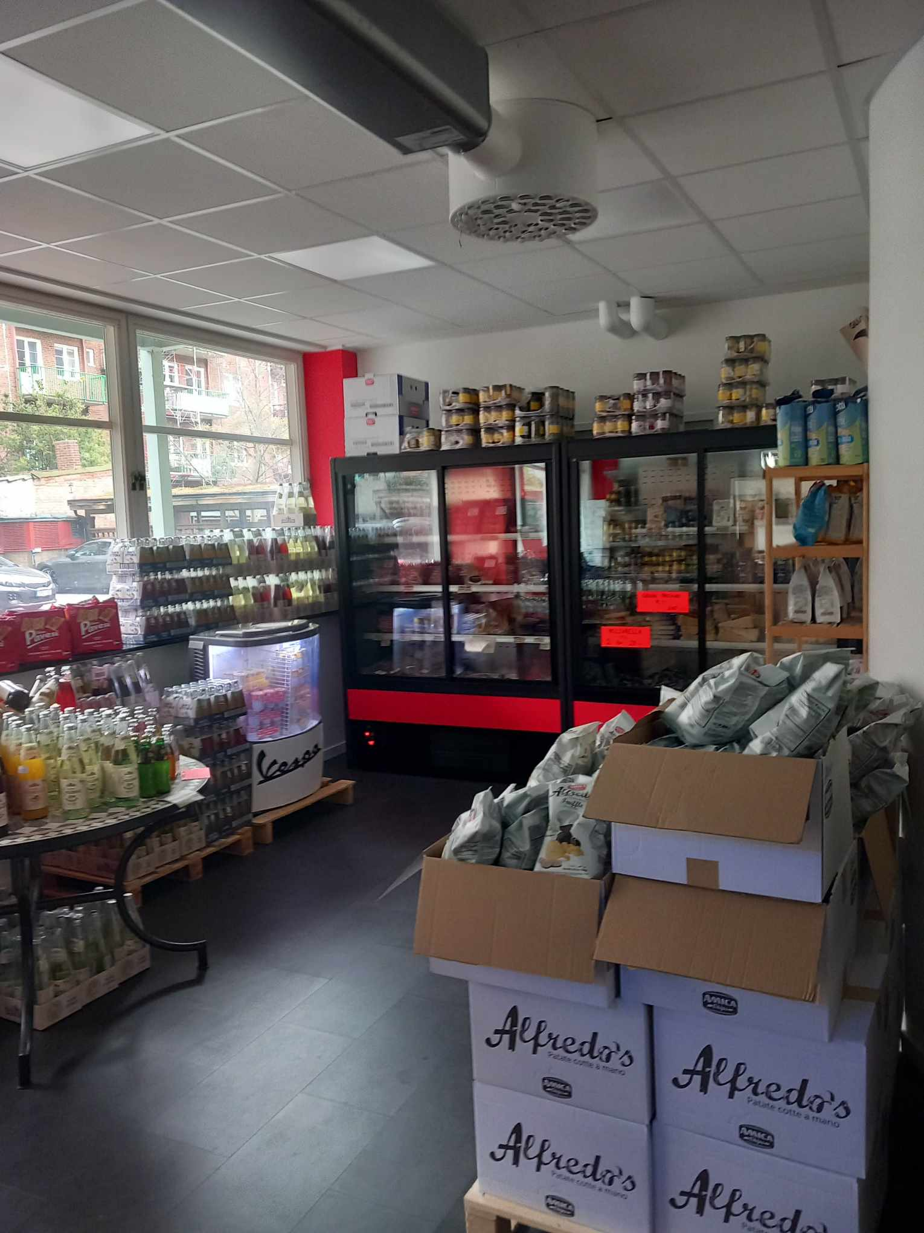
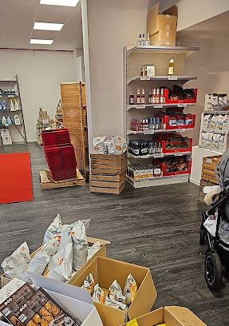
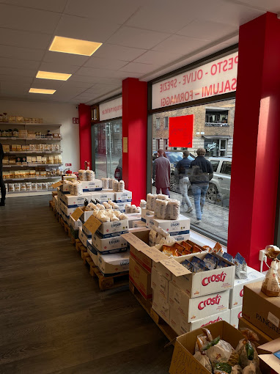
Photos of Italian Super Market

Slide 10
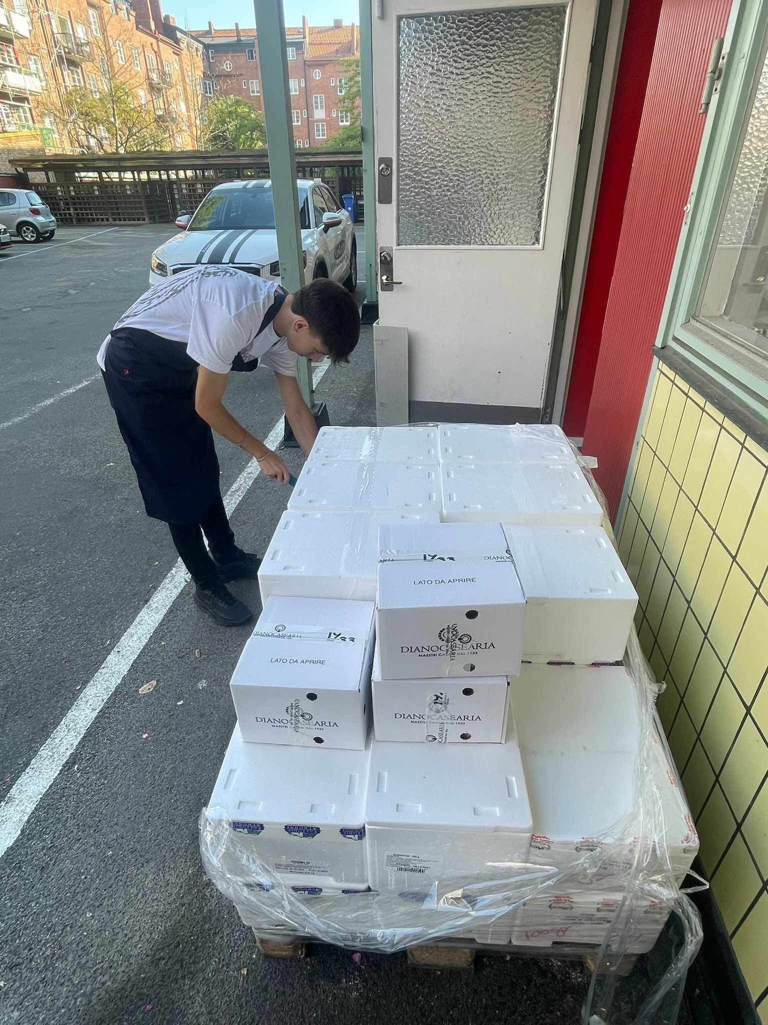
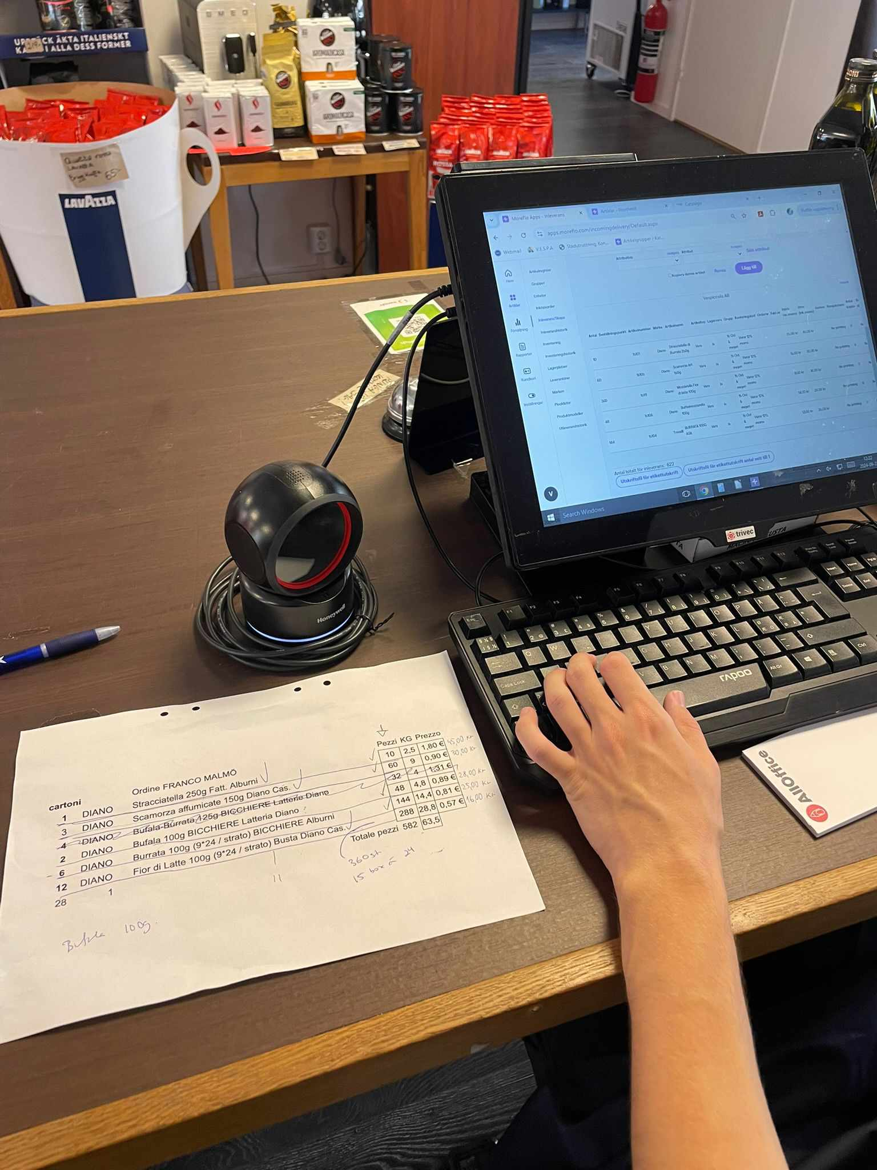
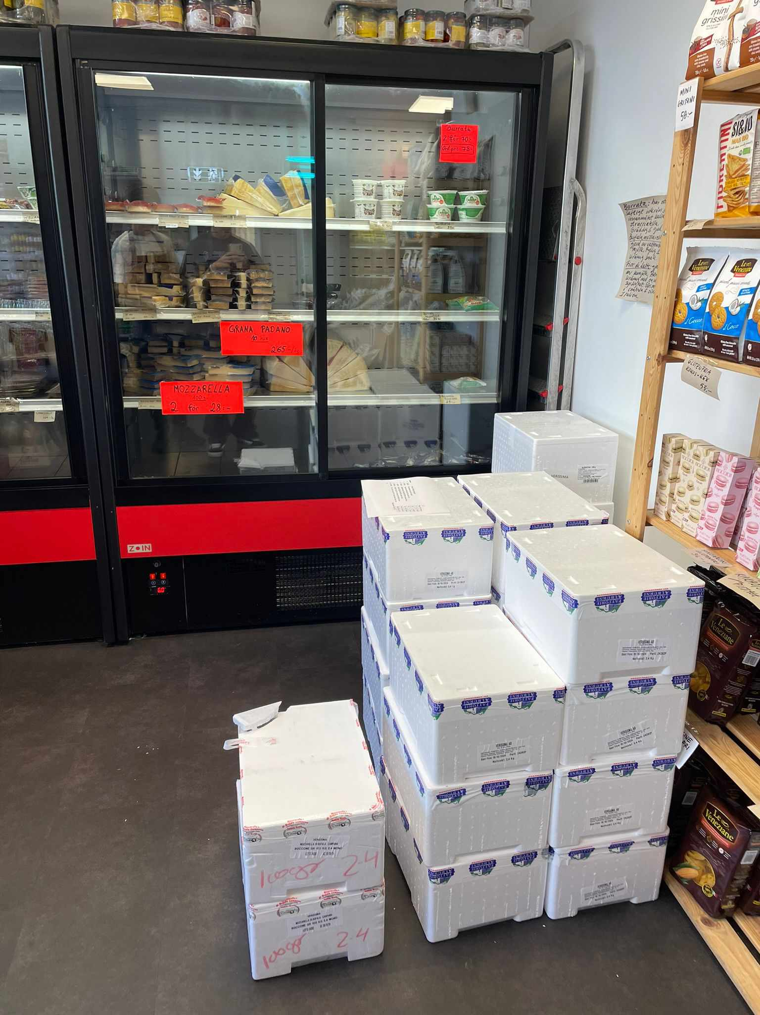
Workplace

Slide 11
Inventory
Delivery note
Descriptions of activities performed
Complaints procedure
Creating store statistics
Receiving delivery
Summary of products in store

Slide 12
Activities performed
Every day when we arrived at the company, we announced our arrival and signed in the book in which employees record their arrival and departure, then before opening the store, we turned on the lights in the store and adjusted the appearance of the store for customers.
During the day, the order always arrived, which we unpacked and counted each product according to the delivery note. Then, we unloaded the goods at the store and, according to the delivery note, we uploaded the goods into the system in the exact number as on the order.
The mentor gave us the task of making business statistics for the year 2024. We decided to do it using the Excel program, where we made graphs in which individual months were compared. We printed out our work, showed it to the mentor, and she was satisfied with the work.

Slide 13
The internship in Malmö allowed me to learn about how store works in general and how to handle administrative work.
They taught me a lot of new things about how to run a store
I had the opportunity to use and improve my English
Working in Italian Super Market has taught me many things and I 'm very happy for the opportunity to work with them
Contribution from practice

Slide 14
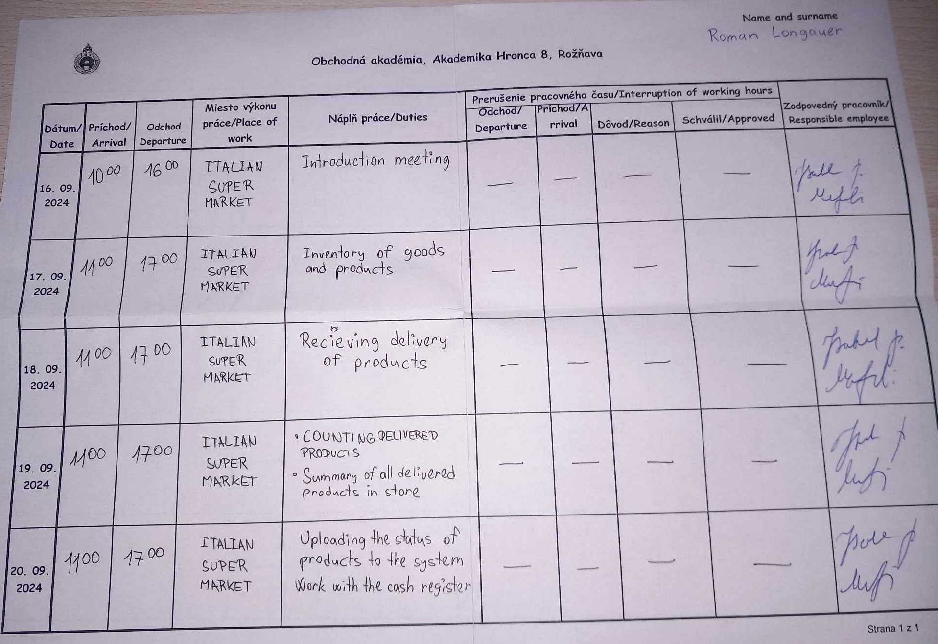
J O U R N A L
1
W E E E K

Slide 15
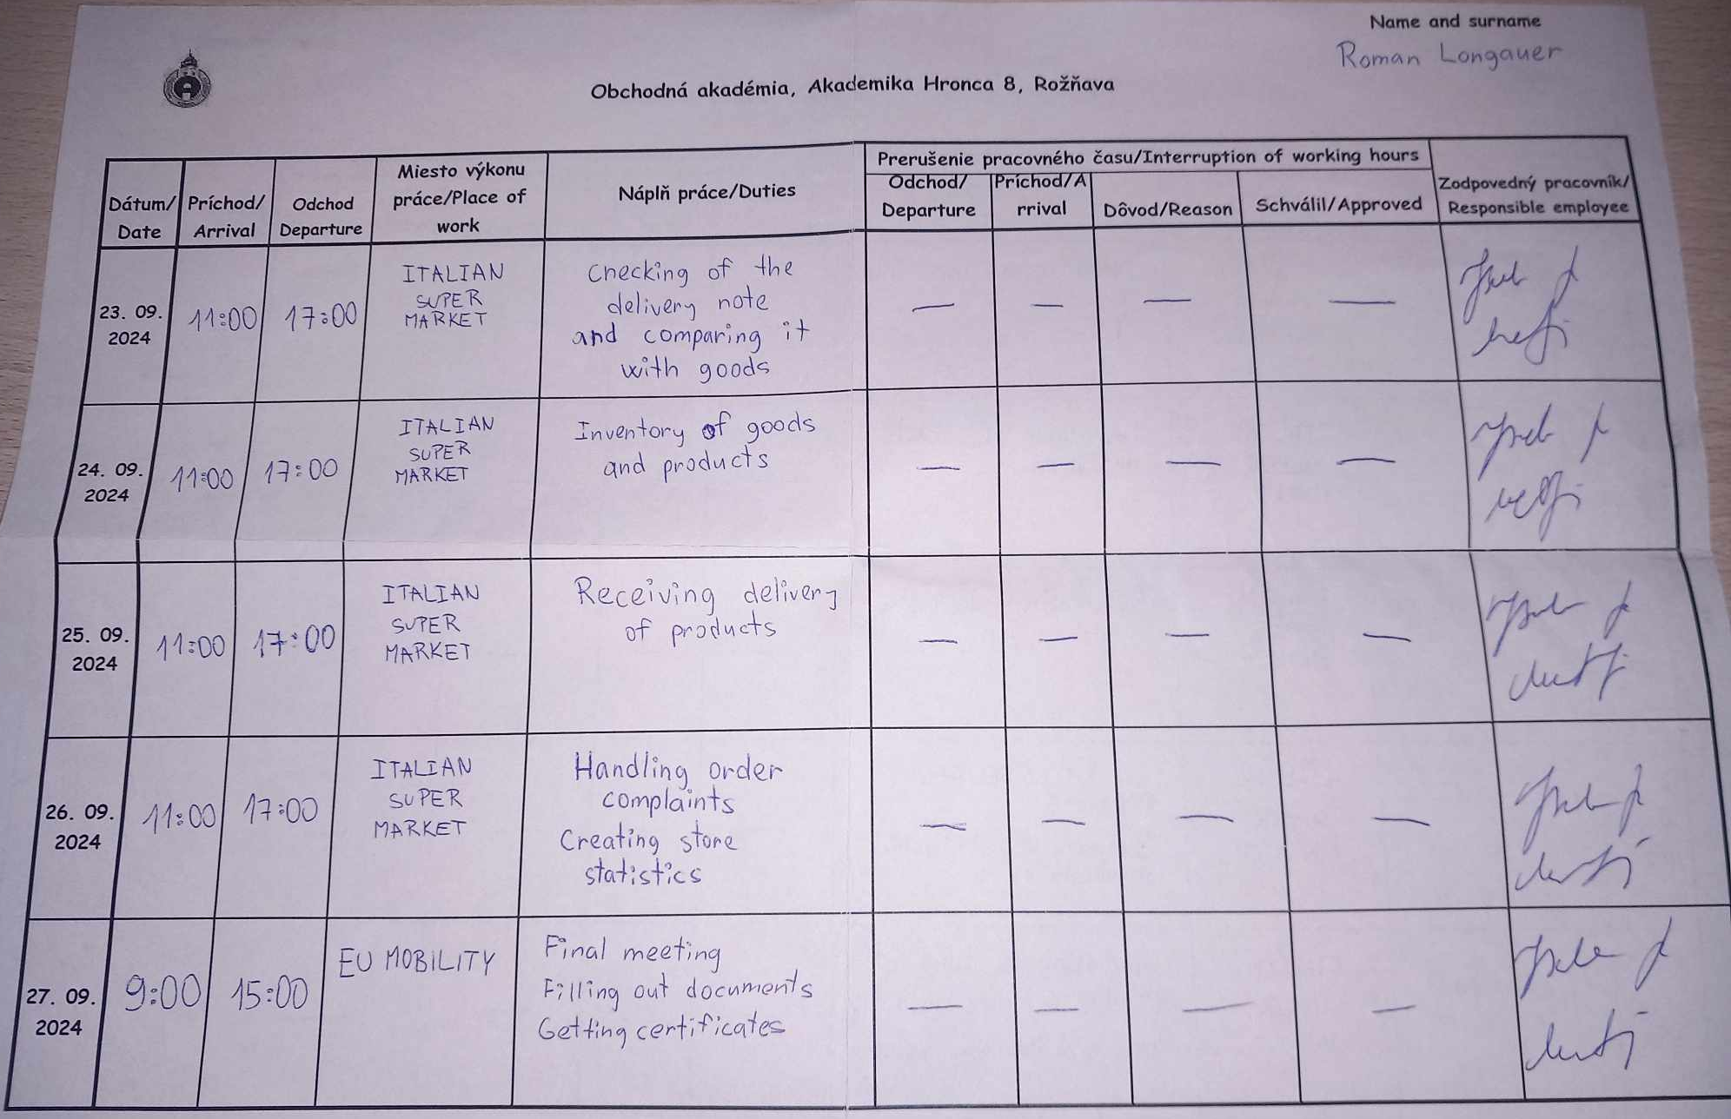
J O U R N A L
2
W E E E K

Slide 16
Used
https://en.wikipedia.org/wiki/Malm%C3%B6
Information
https://vespa.nu/kontakt/

Slide 17
Thank you for your attention

