Slide 1
Report from Internship
Stevens Consulting Group
Michal Bergel
V. Á
2024/25

Slide 2
Content
Introducing the company
Subject of activity
Organizational structure
Clientele
History and achievments
Description of performed activities
Workplace
Visiting sustainable shops
Performed activities
Diary from practice
Benefit from internship
Resources

Slide 3
STEVENS CONSULTING GROUP
hello@stevensconsulting.se
+46 (0) 76 979 7990
Skåne, Sweden
Legal form: limited liability company (LTD)

Slide 4
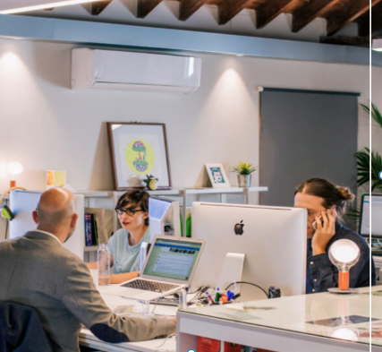
Subject of activity
Business consulting
Financial consulting
Consulting in the field of digitization
Change and innovation management
Marketing and business strategies
Development of human resources

Slide 5
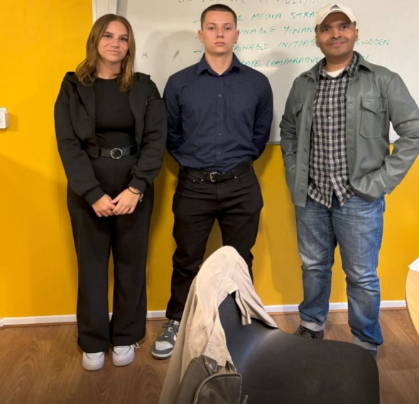
Organizational structure
Sean Stevens
Senior consultant, co-founder, transformation and change management
Jens K. H.
Legal Attorney, Consultant
Erik Karlsson
Senior Consultant. Threat Intelligence
Shamendra Bimba
Consultant

Slide 6
Organizational structure
Year | Number of employees
2012 | 3
2015 | 4
2018 | 6
2020 | 7
2024 | 9

Slide 7
Clientele
Industrial companies
Companies with global retail
Cyber and information security companies
Manufacturing companies
European and global companies

Slide 8
History and achievments
10 years of consulting with KPMG
Transforming Ikea's workforce in 32 countries
Implementation of ISO27001 standards at Delta Spike

Slide 9
Performed activities
Writing an article about potential employees
Creating a presentation and research on potential competitors
Research on financial sustainability
Using artificial intelligence
Visiting sustainable companies
Creating a presentation and research on social media

Slide 10
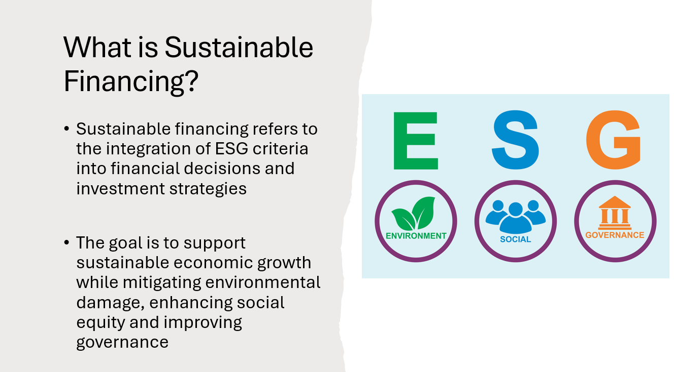
Performed activities

Slide 11
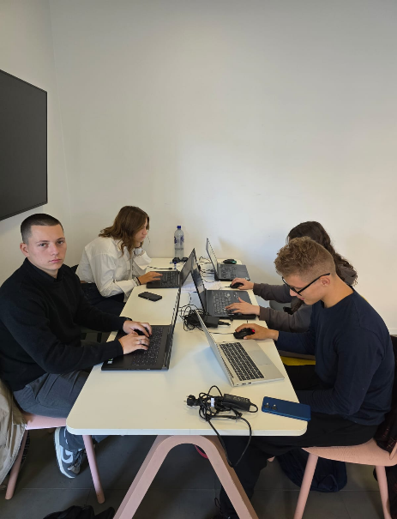
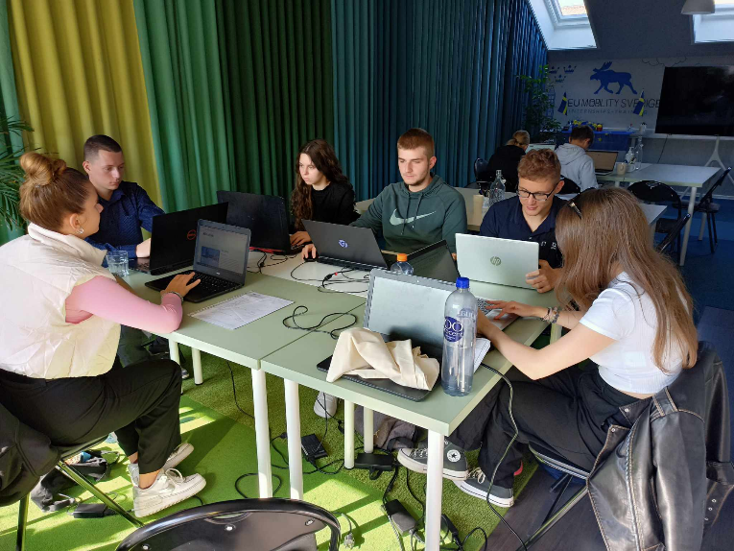
Workplace

Slide 12
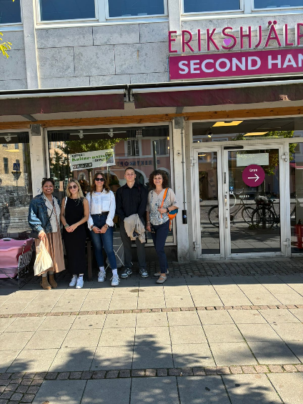
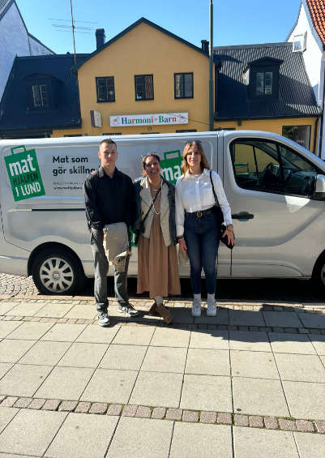
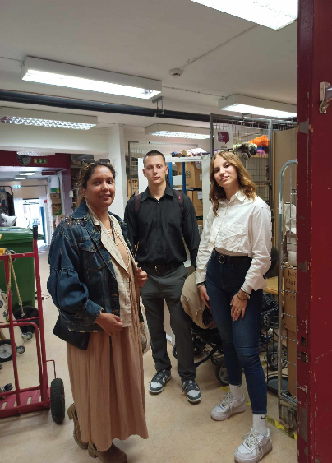
Visiting sustainbale shops

Slide 13
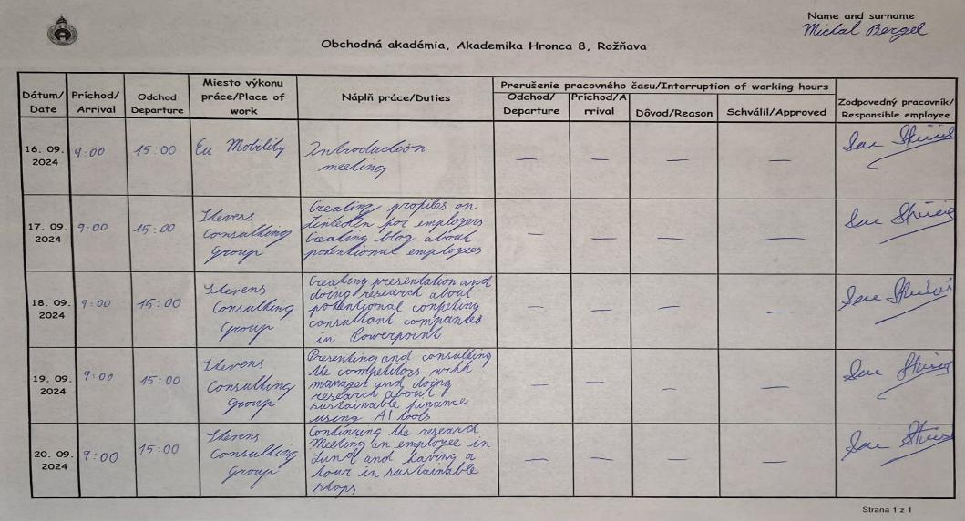
diary – 1. week

Slide 14
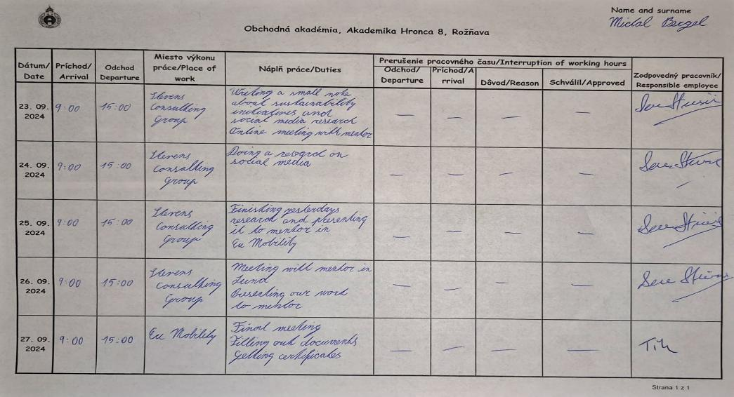
diary – 2. week

Slide 15
The benefits of Internship
During my 2-week internship abroad I had the opportunity to improve my language skills
I learned how to research information and create appropriate presentations based on it
I got to know work life in Sweden
My independence, responsibility and adaptability skills have improved

Slide 16
resources
https://stevensconsulting.se/
https://sk.m.wikipedia.org/wiki/S%C3%BAbor:Ikea_logo.svg
https://deltaspike.io/
https://en.wikipedia.org/wiki/KPMG
Own resources

Slide 17
Thank you for your attention

