Slide 1
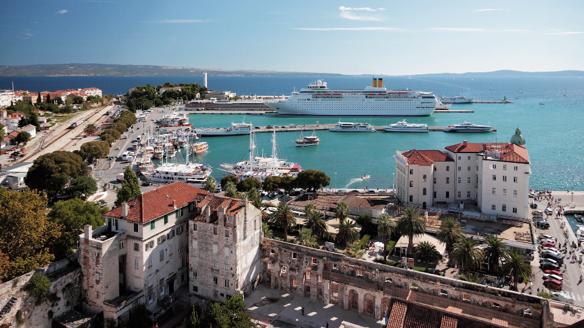
Internship Report Croatia, Split
Tobias Maxin, V. A

Slide 2
PRESENTATION CONTENT
Croatia and Split
Hotel ART
Organiational structure of Hotel ART
Performed activities in Hotel ART
Internship report – first week
History of Hotel ART
Hotel ART Gallery
Hotel CORNARO
Organizational structure of Hotel CORNARO
Performed activites in Hotel CORNARO
Internship report – second week
My workplace in Hotel CORNARO
Hotel CORNARO gallery
Resources

Slide 3
Croatia and Split
CROATIA
a southern European and Mediterranean state on the shores of the Adriatic Sea.
Population – 3,888,529 million
Capital city Zagreb
Currency: since 1. 1. 2023 - EURO
SPLIT
The second largest city in Croatia
Along with Rijeka and Zadar, Split is the main Croatian port
There is a seaport, a military base and also the international airport in Trogir located in Split

Slide 4
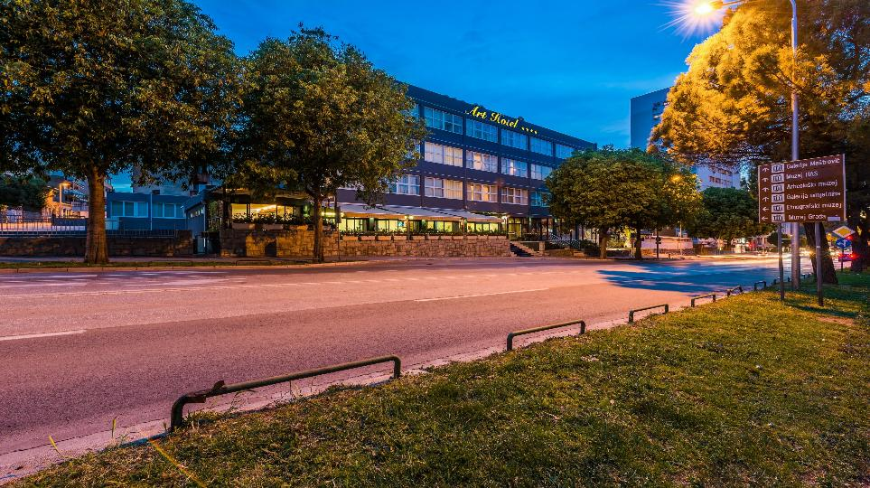
HOTEL ART****
HOTEL CHAIN
SINCE 1930

Slide 5
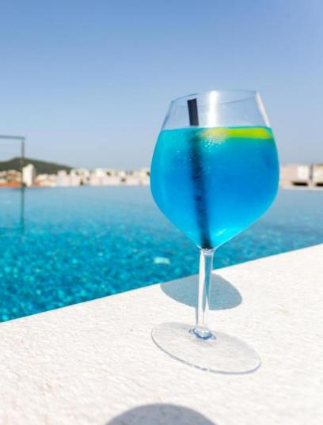
Hotel ART****
Adress: Slobode ul. 41, 21000 Split, Croatia
Phone number: 385 21 302 302
Owner: Viktor Rozić
is located near the historic center of Split
All rooms are equipped with LCD TV and free Wi-Fi.
A rooftop pool with a bar is available for all guests
Reception available 24/7

Slide 6
Organizational structure
Owner
Sanja
Finance Manager Filip
Head of maintenance
Head of waiters
Head of reception
Head of domestics
4 emp.
7 emp.
8 emp.
20 emp.

Slide 7
Performed activites
Assistance with guests' leisure activities
Work with warehouse stocks and their records
Intensive communication with guests and staff in English

Slide 8
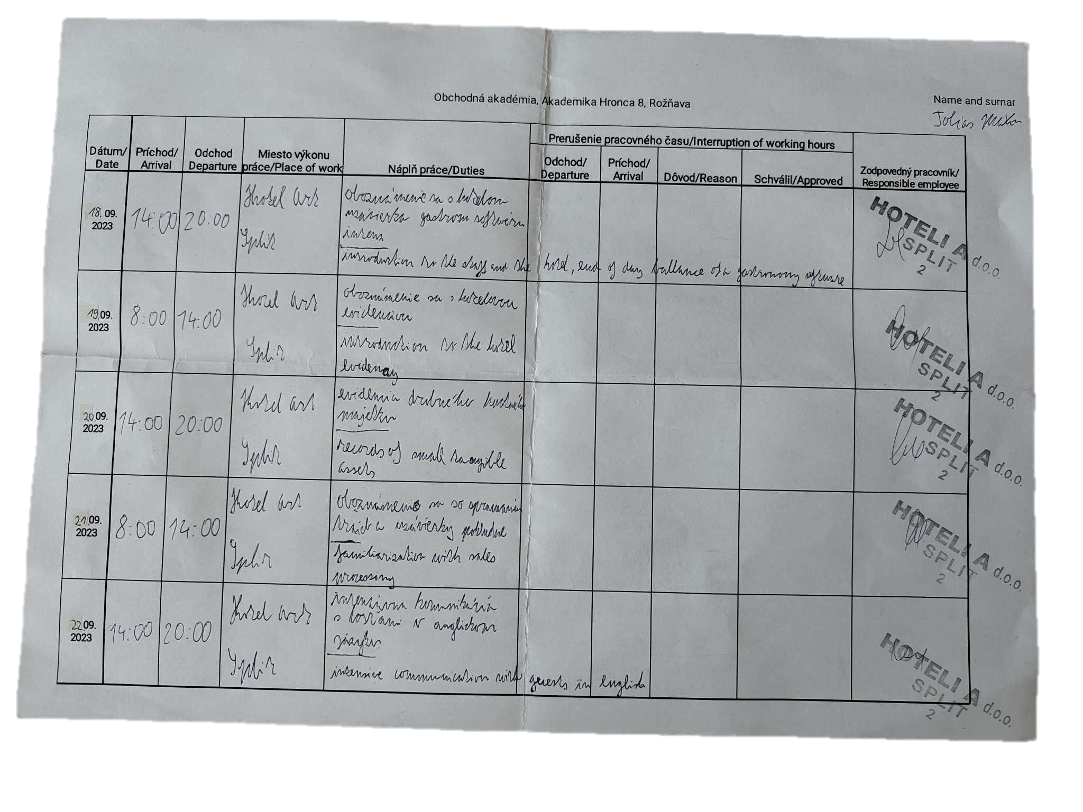
Internship report first week

Slide 9
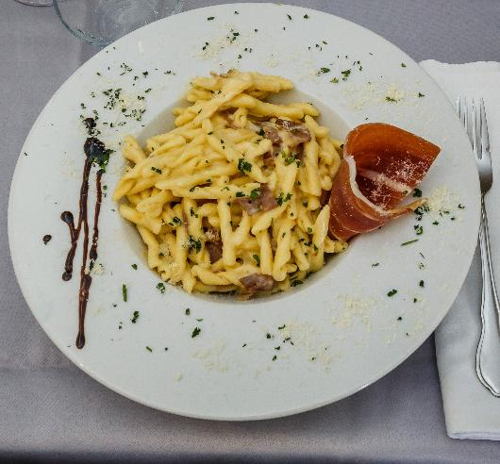
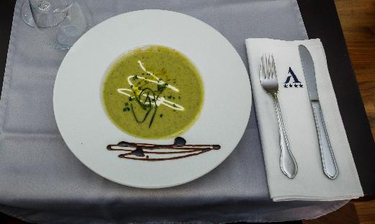
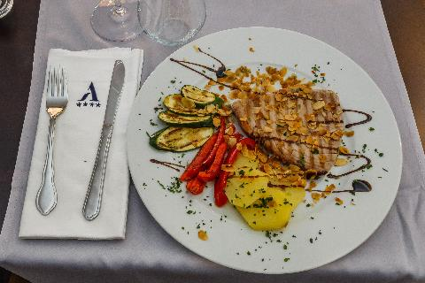
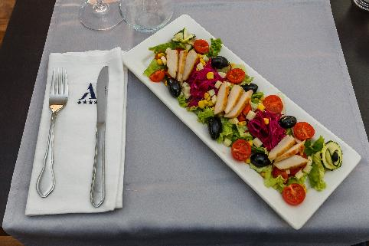
Hotel History
The hotel was once home to one of the best pastry shops in town, Bobis. The building itself was modified and renovated.
Bobis meant tradition, quality and loyalty to old recipes that were once used in Split households. Bobis left his mark on thousands of children and left them with sweet memories.

Slide 10
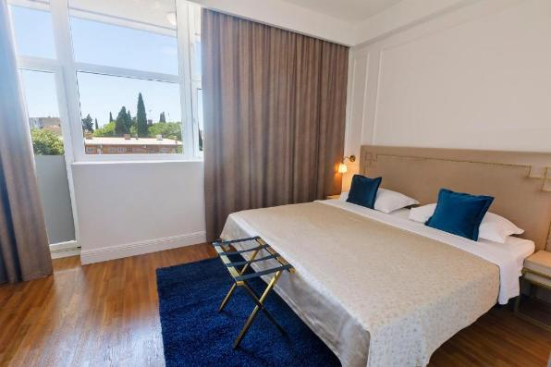
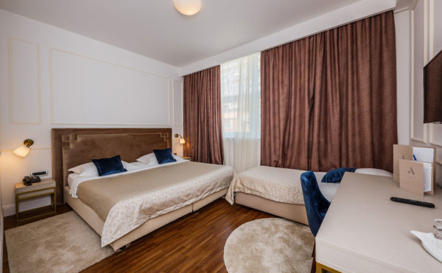
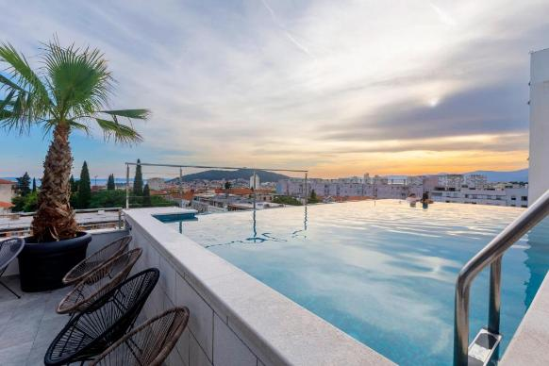
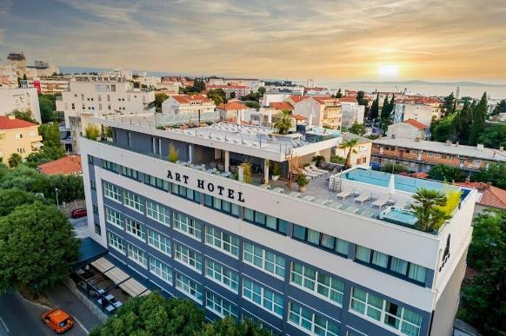
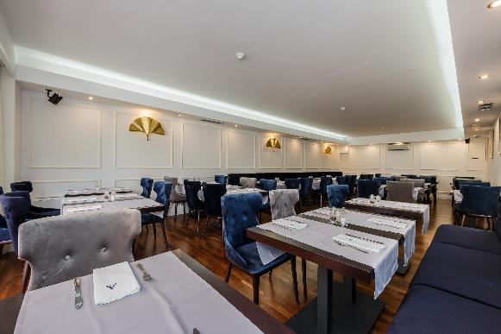
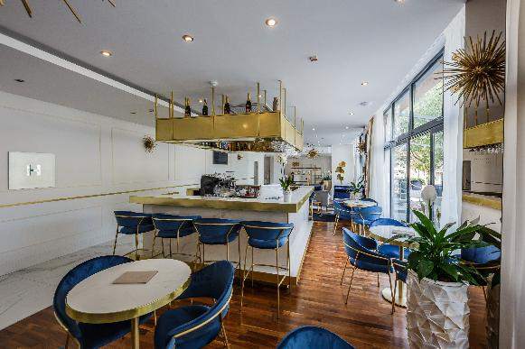
HOTEL GALLERY

Slide 11
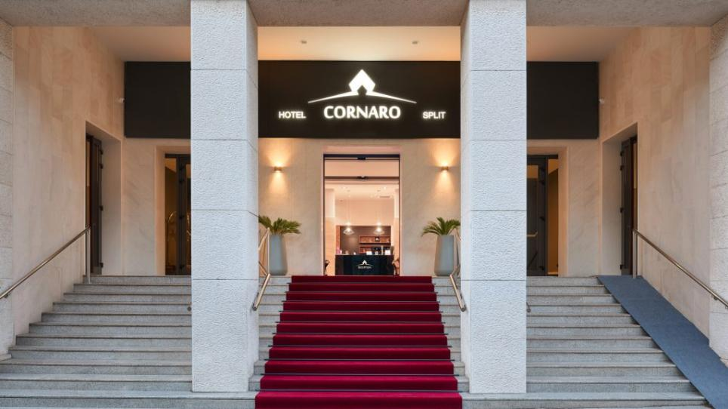

Slide 12
Hotel CORNARO*****
Adress: Sinjska 6, 21000 Split, Croatia
Phone Number: 385 21 644 200
Located in the city centre
Modern rooms with air conditioning and minibar
Private parking
A rooftop pool with a bar is available for all guests, with a beautiful view over the city
The reception is available 24/7, which will gladly help you with the organization of various activities in and around the city
Breakfast buffet included in the price of each accommodation unit

Slide 13
Organizational structure
Owner
Managers
Superior workers
=
=
Domestics and housekeeping employees
Reception employees
Restaurant employees

Slide 14
Performed activites
Check-in and check-out of guests - MILENI software
Monitoring the status of accommodation units - Adria software
Intensive communication with guests
Escorting guests to the conference and to their rooms
Training to work with guests and testing my acquired knowledge

Slide 15
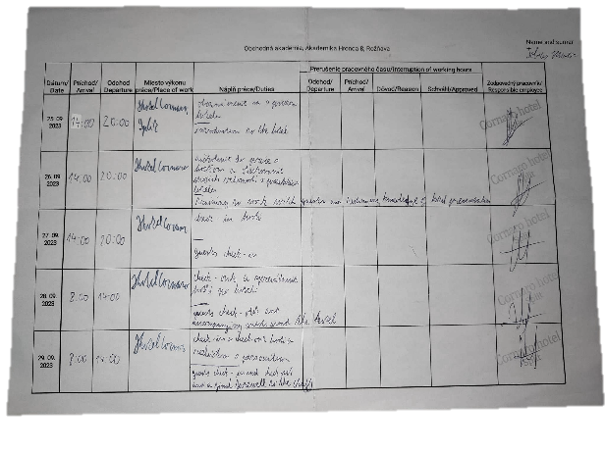
Internship report second week

Slide 16
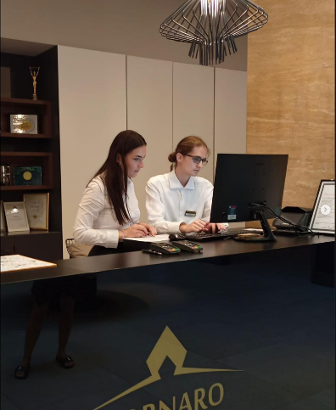
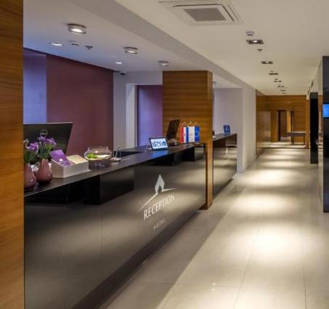
Workplace

Slide 17
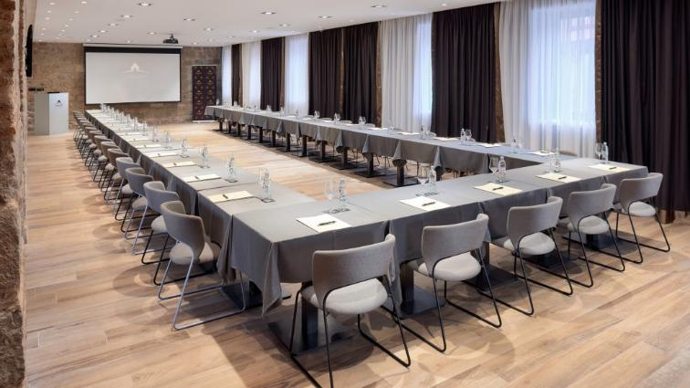
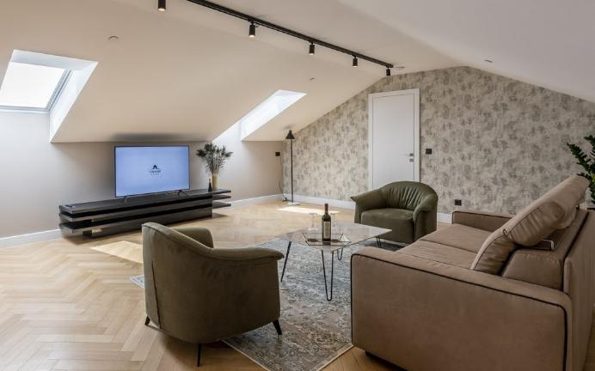
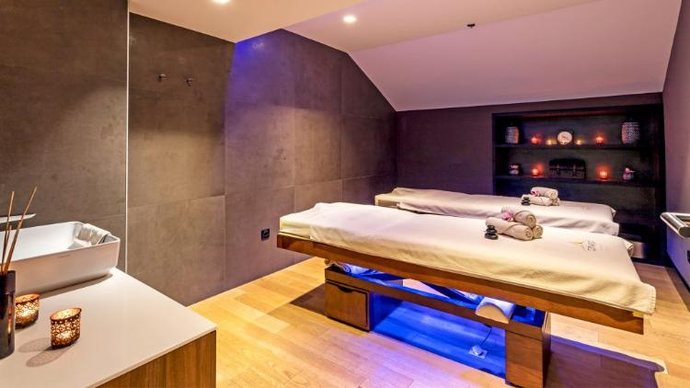
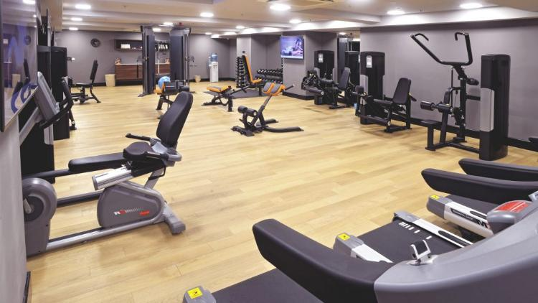
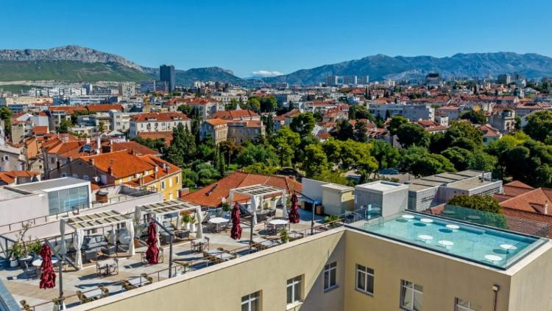
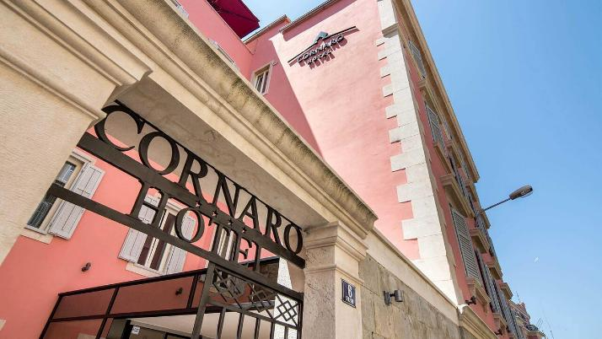
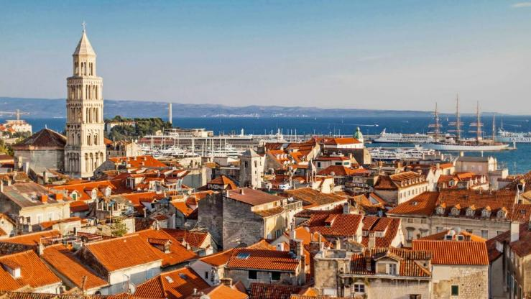
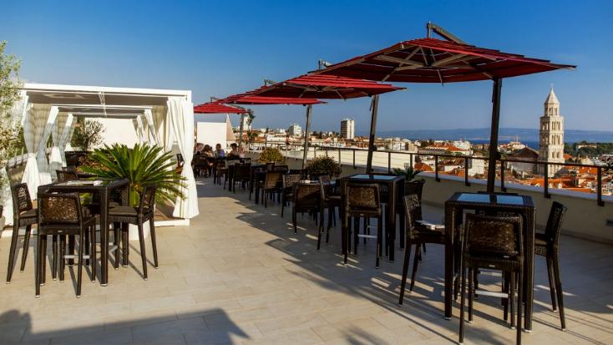
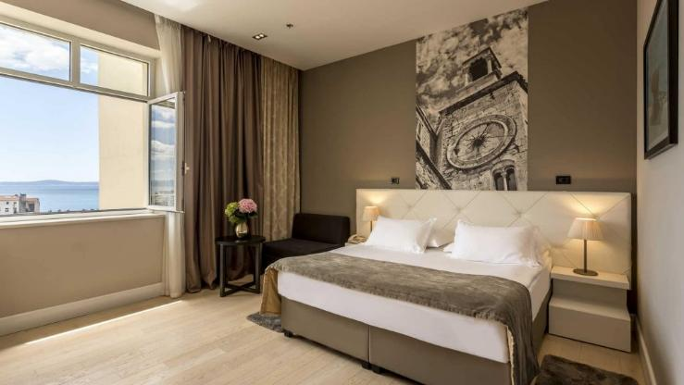
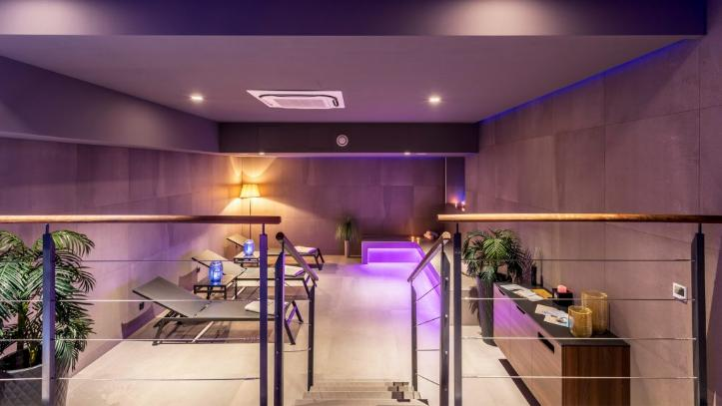
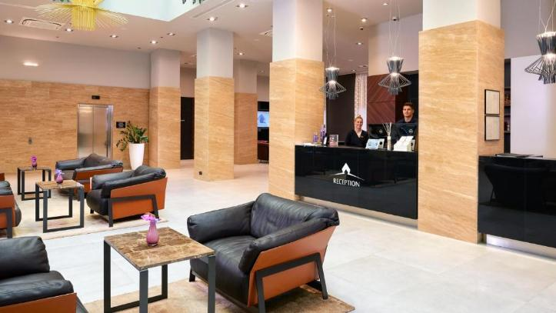
HOTEL GALLERY

Slide 18
Personal internship outcome

Slide 19
RESOURCES
https://arthotel.hr/
https://www.booking.com/hotel/hr/arthotelsplit.sk
https://reserving.com/hotels/europe/croatia/split-dalmatia/split/art-hotel
https://kr.trip.com/hotels/split-hotel-detail-2336456/art-hotel/
https://www.booking.com/hotel/hr/cornaro.sk
https://cornarohotel.com/
https://www.guestreservations.com/cornaro-hotel-croatia/booking?gclid=CjwKCAjw4P6oBhBsEiwAKYVkq2uJWOxZFx6IVqyNEByx1bOBofqWTs5ItnMFwygd27Okor9NT1TDfxoCanMQAvD_BwE
https://www.tripadvisor.com/Hotel_Review-g295370-d6871450-Reviews-Cornaro_Hotel-Split_Split_Dalmatia_County_Dalmatia.html

Slide 20
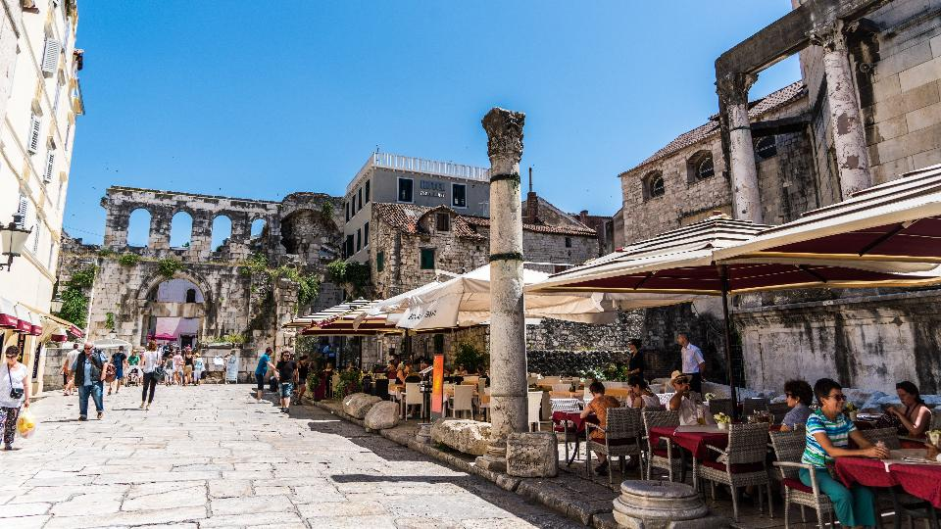
THANKS FOR YOUR ATTENTION!

