Slide 1
Internship Report Hotel FERMAI
Dávid Jozef Hajdu
V. A
2023/24

Slide 2
Table of Contents
Hotel FERMAI
Hotel History
Accommodation
Restaurant and Bar
Clientele
Organizational Structure
My workplace
Activities Performed During Internship
Diary – Week 1
Diary – Week 2
Evaluation and Benefits of the Internship
Sources

Slide 3
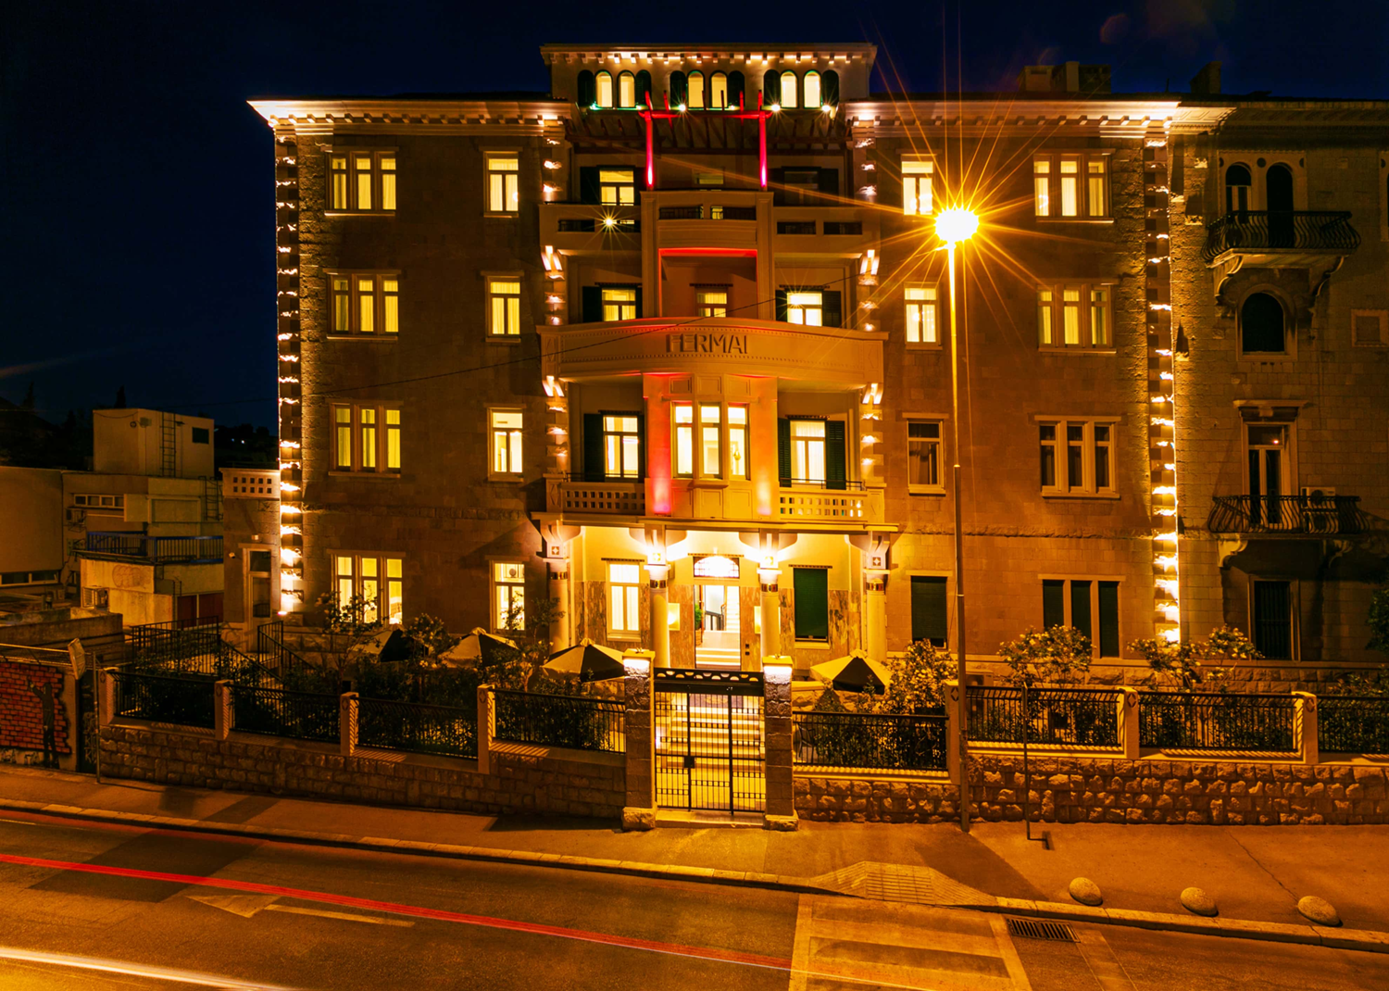
Hotel FERMAI
A 4-star hotel opened since June 2020
Located in the city of Split, the second-largest city in Croatia
Situated in the heart of the city, 500 meters from Diocletian's Palace and near the coastal promenade
QUATRO COMPANY d.o.o.
Hotel FERMAI 4*
Livanjska 5
21000 Split Croatia
 +385 21 278 000
 welcome@hotelfermai.com
✓ hotelfermai.com

Slide 4
Hotel History
The building was originally intended for the needs of a cooperative union
Since 1974, it has been the headquarters of the University of Split
Archaeological findings during construction testify to the existence of organized urban life in Split even before the construction of Diocletian's Palace
The discovery of a bath or fountain indicates that this location was once a wellness area or market

Slide 5
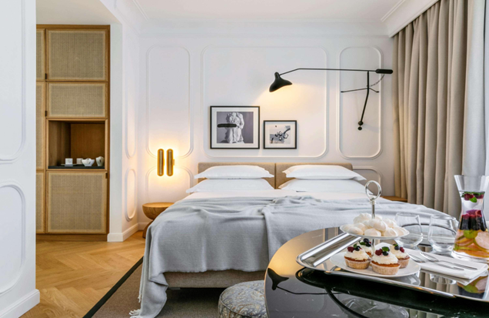
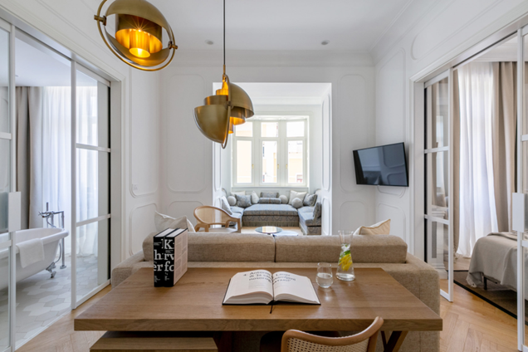
Accommodation
The hotel offers 31 luxurious rooms and 4 luxury suites
Ranging in price from €170 to €1030 per night
Room amenities include: radio, LCD TV, minibar, safe, free WiFi, telephone, soundproof walls and doors, high windows with a beautiful city view

Slide 6
Restaurant and bar
A creative culinary team utilizes local ingredients, providing an authentic gastronomic experience
In line with global culinary trends, it caters to various nutritional needs of guests and also offers vegetarian, vegan, and gluten-free dishes
Head chefs always come up with new ideas or recipes to pleasantly surprise the guests

Slide 7
Clientele
Guests from various countries around the world come to the hotel
However, the majority of guests come from Canada, Australia, and the United States
From Europe, the most visitors come from France and Germany
Other guests include those from China, Brazil, Spain, and of course, Croatia

Slide 8
Organisational structure
General manager
Maintenance
Head of finance
Reservations agent
Front office manager
Main waiter
Main chef
Head of housekeeping
Accountant
HR specialist
Purchaser
Recepcionist
Young recepcionist
Bellboy
Waiter
Cook
Young cook
Maid

Slide 9
My workplace
The place where I carried out most of my tasks
The office of the manager and accountant

Slide 10
Activities performed during internship
Invoice Verification
I verified invoices on paper and in the hotel system to ensure that the amount, guest name, room number are similar, and, if the guest paid by card, the amount on the receipt matched with the bank
Breakfast Report Check
Every day after breakfast, a report was compiled detailing the consumption of food and beverages, and I had to calculate the total amount based on the provided template with individual prices
Calculation and Summarization of Welcome Drinks
I had to calculate the total amount for welcome drinks and summarize it in Excel, then send it to the accountant

Slide 11
Activities performed during internship
Calculation of Breakfast Costs
I calculated the overall expenses and costs for breakfast for the years 2021, 2022, and 2023
Recording Foreign Invoices
I maintained a record of invoices in Excel that the hotel received from abroad, and at the same time, I had to verify them
Transportation List Verification
I verified the list of transportation services provided by the hotel from the airport, ensuring that the details were recorded in the system for the convenience of other employees

Slide 12
Diary – Week 1

Slide 13
Diary – Week 2

Slide 14
Evaluation and Benefits of the Internship
I am overall very satisfied with the internship and the place where I worked.
I learned a tremendous amount of new things and gained insight into how the entire hotel operations function, from guest reception to recording various hotel invoices
Despite the language barrier as the hotel program was in Croatian, I managed to learn how to work with it
I had the opportunity to refresh my existing skills in Excel and improve my communication and English language proficiency.
Throughout the internship, I gained valuable experiences, and I hope to apply them in the future

Slide 15
Sources
https://www.hotelfermai.com/
https://all.accor.com/hotel/B8U9/index.en.shtml

Slide 16
Thank you for your attention

